Slide 1
Bit Error Probability Evaluation of RO PUFs
Qinglong Zhang, Zongbin Liu, Cunqing Ma and Jiwu Jing
Institute of Information Engineering, CAS, Beijing, China
ISC 2015
Notes:
Hello，everyone。My name is Qinglong Zhang. I am from the institute of information engineering, Chinese academy of science, Beijing China. I’m very glad that I can present my paper “bit error probability evaluation of RO PUFs”.

Slide 2
Outline
Introduction
Analysis Model
Experiments
Conclusion
Notes:
My presentation is divided into four parts. First is the introduction, then are the analysis model and experiments. Finally is the conclusion.

Slide 3
Outline
Introduction
Analysis Model
Experiments
Conclusion
Notes:
First is the introduction of ring oscillator puf.

Slide 4
Introduction
In security applications,
a challenging problem is the key protection
1, key generation ( random )
2, key storage (strict access)
Physically Unclonable Function is an excellent choice for this problem.
Notes:
In security applications, a challenging problem is the key protection which includes key generation and key storage. In the key generation, there need random numbers to generate keys. And in the key storage there should be strict access to the key in order to prevent the key from being stolen. Physically uncloable function is an excellent choice for this problem.

Slide 5
Physically unclonable function (PUF)
Two identical circuits can not be created in practice.
Process variation is intrinsic and random.
Process variation is uncontrollable and the manufacturer can not reproduce the process variation.
The random secret is extracted from the electrical property and there needs no non-volatile memory.
Notes:
The concept of physically unclonable function is that two identical circuits can not be created in practice. Process variation is intrinsic and random. Meanwhile, process variation is uncontrollable. Even if the manufacturer can not reproduce the process variation. What’s more, the random secret is extracted from the electrical property and there doesn’t need non-volatile ['vɒlətaɪl] memory.

Slide 6
There are many types of PUFs:
Ring oscillator PUF
Arbiter PUF
SRAM PUF
Glitch PUF
Notes:
There are many types of PUFs, such as ring oscillator PUF, arbiter puf, sram puf and glitch puf and so on.

Slide 7
How to evaluate the PUF:
reproducibility: one challenge is used multiple times, the difference between responses should be as small as possible
Uniqueness: different challenges are used one time, the difference between responses should be as large as possible
Notes:
To evaluate PUF, there are two main parts. One is the reproducibility and the other is uniqueness. Reproducibility is that one challenge is used multiple times, the difference between responses should be as small as possible. Uniqueness is that different challenges are used one time, the difference between responses should be as large as possible.

Slide 8
The existence of noise
The effect of some process variation is close to the effect of noise.
Therefore, responses may have some errors.
Generally, fuzzy extractors are used to correct the errors.
The error rate is higher, and the cost of fuzzy extractor is more.
Notes:
Usually, reproducibility can not reach to one hundred percent, because the existence of the noise and the effect of some process variation is close to the effect of noise. Therefore, responses may have some errors. Generally, fuzzy extractors are used to correct the errors. But The error rate is higher, and the cost of fuzzy extractors is more.

Slide 9
We focus on the bit error probability of RO PUFs.
The factors which can affect the bit errors:
Voltage
Temperature
Reference counting value
Based on the RO’s classical oscillation model, we analyze the bit error probability of RO PUFs
Notes:
We focus on the bit error probability of RO PUFs. The factors which can affect the bit errors are the voltage, temperature and the sampling interval. Based on the RO’s classical oscillation model, we analyze the bit error probability of RO PUFs.

Slide 10
Related work
Komurcu et al.[1] list several factors to affect the bit error probability, and present the measure time’s effect on the bit error probability roughly.
Hiller et al.[2] describe the relationship between the number of sample elements and the bit error probability. Based on multiple frequency measurements, the bit error probability can be estimated.
[1] Komurcu, G., Pusane, A.E., Dundar, G.: Analysis of ring oscillator structures to develop a design methodology for RO-PUF circuits. In: Very Large Scale Integration (VLSI-SoC), pp. 332–335 (2013)
[2] Hiller, M., Sigl, G., Pehl, M.: A new model for estimating bit error probabilities of ring-oscillator PUFs. In: Reconfigurable and Communication-Centric Systems-on-Chip (ReCoSoC), pp. 1–8 (2013)
Notes:
Komurcu list several factors to affect the bit error probability, and present the measure time’s effect on the bit error probability roughly.
Hiller describe the relationship between the number of sample elements and the bit error probability. Based on multiple frequency measurements, the bit error probability can be estimated.

Slide 11
Contribution
According to the basic RO characteristics, we describe our bit error calculation model which can quantitatively calculate the bit error probability with basic oscillation parameters.
Our work contributes to the evaluation scheme of RO PUFs and can help designers efficiently construct RO PUF with an acceptable bit error rate.
Notes:
According to the basic RO characteristics, we describe our bit error calculation model which can quantitatively calculate the bit error probability with basic oscillation parameters。Our work contributes to the evaluation scheme of RO PUFs and can help designers efficiently construct RO PUF with an acceptable bit error rate.

Slide 12
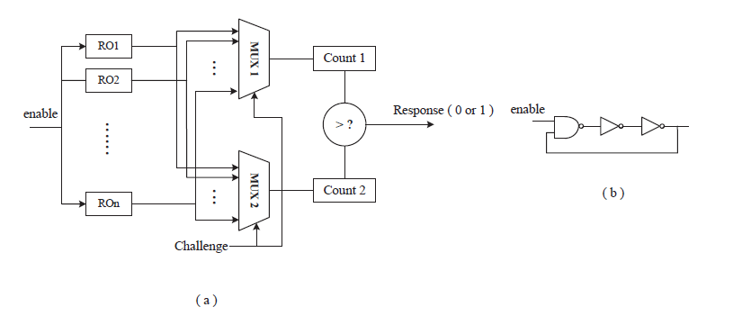
Ring Oscillator PUF
Notes:
Ring oscillator architecture is a typical method to construct PUFs. The ring oscillator PUF is first proposed by Suh and Devadas. The left figure (a) shows that an RO PUF is composed of n identical ROs, RO1 to ROn, with frequencies, f1 to fn, respectively. Generally, RO PUF also contains two counters and two n-to-1 multiplexers that control which ROs are currently applied to both counters. The right figure shows a three-stage ring oscillator. Due to intrinsic process variation, fi and fj will differ from each other. One bit response rij can be extracted from two ring oscillators by using a simple comparison of their frequencies.

Slide 13
Evaluation scheme
Intra-distance μ_{intra} (bit error probability, reliability)
Apply the same challenge C to a PUF m+1 times, and get the n-bit response Ri (1<= I <= m+1).
Select the R_{m+1} as the reference response
Calculate the μ_{intra} as follow.
Notes:
Reproducibility is evaluated by the intra-distance. Apply the same challenge C to a PUF m+1 times, and get the n-bit response Ri. Then Select the Rm+1 as the reference response. Then calculate the intra-distance as the following formula.

Slide 14
Outline
Introduction
Analysis Model
Evaluation
Conclusion
Notes:
Here is the analysis of the model on the bit error probability

Slide 15
In order to simplify the scenario for the analysis, we assume that except the Gaussian noise there are no other interferential signals to affect RO’s oscillations.
In our model, there are two random variables:
Process variation
Gaussian noise
Notes:
In order to simplify the scenario for the analysis, we assume that except the Gaussian noise there are no other interferential [,intəfə'renʃəl] signals to affect RO’s oscillations. In our model, there are two random variables: process variation and Gaussian noise.

Slide 16
Oscillation model
The period of one ring oscillation between two rising edges is X_{k}, which is affected by two parts:
Intrinsic manufacturing factor
Gaussian noise
In CHES 2014, Ma et al. give an assumption that the X_{k} is i.i.d. The mean and variance of X_{k} are denoted as μ and σ2, and the variance constant r is defined as follows.
Notes:
The period of one ring oscillation between two rising edges is X_{k}, which is affected by two parts: intrinsic manufacturing factor and gaussian noise.
In CHES 2014, Ma et al. give an assumption that the Xk is independent identically distributed. The mean and variance ['veərɪəns] of Xk are denoted as μ and the square of σ. The variance constant r is defined as follows.

Slide 17
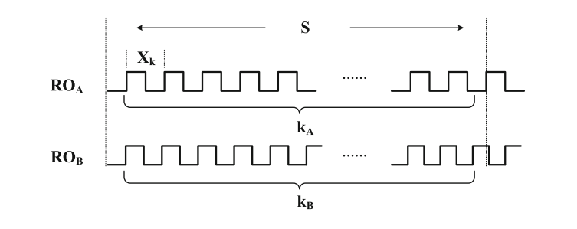
In a sampling interval S, ROa has k_{A} periods
ROb has k_{B} periods
Notes:
In a sampling interval S, The ring oscillator Roa has ka periods and ring oscillator Rob has kb periods.

Slide 18
Let Ni = max{ k | Tk < S } and Ni is the number of periods in sampling interval.
The probability Prob(Ni = k) is calculated as follows.
Notes:
The relationship between the number of period and the sampling interval is described as these formulas. Let Ni equals to the max of k which satisfies that Tk is less than S, and Ni is the number of periods in sampling interval. The probability (Ni = k) is calculated as the following formula.

Slide 19
Based on the central-limit theorem
Then, we can get Prob (Ni = k) as follows.
Where v = S/μ.
Notes:
Based on the central-limit theorem, the distribution of Tk is deduced as the following formula. Then we can calculate the probability of Ni equals k as follows and use the probability of Tk.

Slide 20
In J.Cryptol.2011, Maiti et al. give a model to describe the delay of ring oscillators.
If the process variation is that μA > μB and there is no noise influence, the one-bit response from ROa and ROb is stable. However, the cumulative influence of noise may be larger than that of the process variation.
Notes:
In the journal of crypto 2011, Maiti give a model to describe the delay of ring oscillator. As the following formula. Where dAV G is the nominal delay value and it is the same for all the identical ROs. dPV is the delay variation resulted from random process variation. dNOISE is the delay variation due to the environmental noise. If the process variation is that μA is lager than μB and there is no noise influence, the one-bit response from ROa and ROb is stable. However, the cumulative influence of noise may be larger than that of the process variation,so there may be some bit errors.

Slide 21
The bit error probability can be denoted as Prob_{error}.
k_{a} and k_{b} are denoted as the measured counting values in a sampling interval.
First, we calculate the probability Prob( ka > kb).
Notes:
The bit error probability can be denoted as Proberror as this formula. Where ka and kb are denoted as the measured counting values in a sampling interval. First, we can calculate the probability (ka is larger than kb)as the following formula.

Slide 22
Then Calculate the Prob ( ka > kb )
Notes:
During the calculation, the sum of the probability of kb = j can be calculated as the above formula. Then we can calculate the probability of ka is larger than kb.

Slide 23
Prob( ka > kb | μａ＞μｂ) + Prob( ka ＜ kb | μａ＜μｂ)
to estimate the bit error probability
Assume the process variation distribution is a normal distribution with the probability density function.
That’s to say, for m ROs,
Notes:
The sum of these two contingent probabilities can be used to estimate the bit error probability. Assume the process variation distribution is a normal distribution with the probability density function as follows.

Slide 24
The sampling interval S
RO PUF’s variance constant r
The probability density function fPV(x)
Notes:
Based on the above formulas, we can get the contingent probability. In the calculation of this probability, there are three factors, the sampling interval, the variance constant and the density function of process variation.

Slide 25
Outline
Introduction
Analysis Model
Experiments
Conclusion
Notes:
Here is the experimental description on the bit error probability

Slide 26
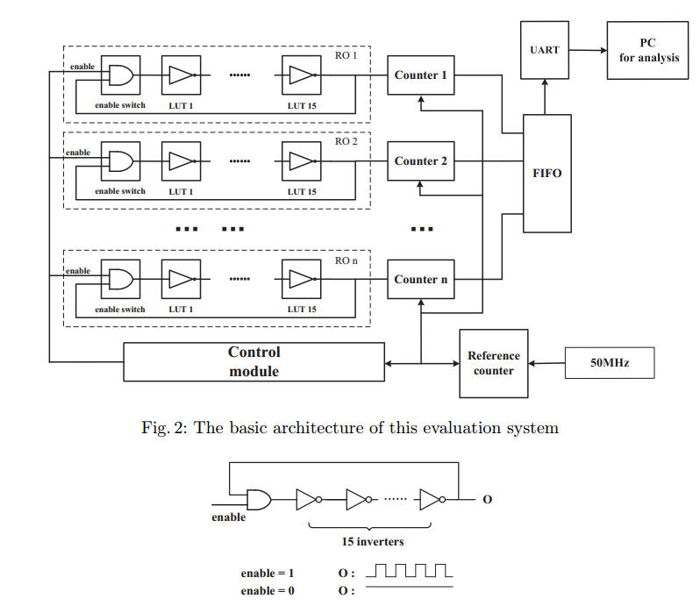
Notes:
we conduct practical experiments on fifteen Xilinx Virtex-5 FPGA boards. there are 1024 ROs deployed in every board. And a 50 MHz crystal oscillator onboard is used for the setting of the sampling interval S. The ring oscillator is composed of 16 LUTs. One is used as a 2-input AND gate for the enable signal, and the other 15 LUTs serve as inverters.

Slide 27
Parameters Extraction
To extract the parameter of process variation
When the crystal oscillator has Nco oscillations, record the counters that driven by all the ROs.
To extract the variance constant r
When the RO has N oscillations, record the counter of the crystal oscillator’s oscillation.
Notes:
To way to extract the parameter of process variation, is that when the crystal oscillator has Nco Oscillations, record the counters that driven by all the ROs.
To way to extract the variance constant r, is that when the RO has N oscillations, record the counter of the crystal oscillator’s oscillation.

Slide 28
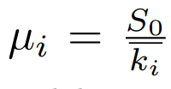
For one RO, its oscillation period is a normal distribution.
Every oscillation period is i.i.d.. In sampling interval S0, there are oscillations and the sum’s distribution is
Notes:
For one RO, its oscillation period is a normal distribution. Every oscillation period is independent identically distributed. In sampling interval S, there are ki oscillations and the sum distribution is as follow. And we can calculate the μi by dividing S zero and ki. Then based on μ one，μ two，μ three and so on, we can get a rough evaluation of the distribution of process variation.

Slide 29
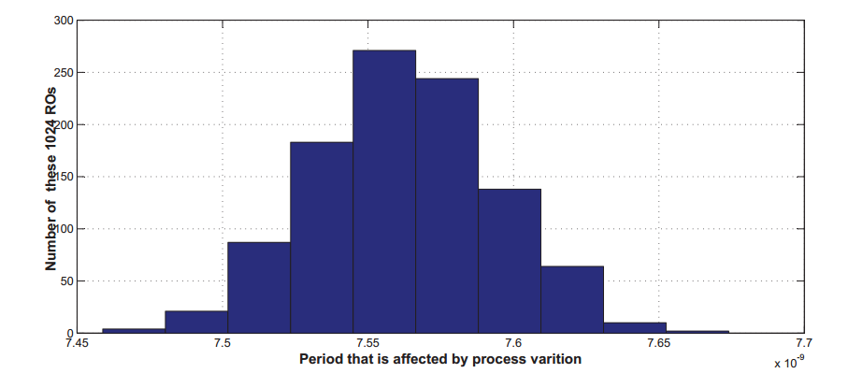
Notes:
This is the distribution of the process variation.

Slide 30
For one RO, when it has N oscillation, record the counter of the crystal oscillator’s oscillation and repeat this operation 1000 times.
The variance constant r = σ²/μ
For multiple ROs, regard the average variance constant for the model calculation.
Notes:
For one RO, when it has N oscillation, record the counter of the crystal oscillator’s oscillation and repeat this operation 1000 times. Then calculate the variance constant.
For multiple ROs, regard the average variance constant for the model calculation.

Slide 31
Model calculation
1.
2.
Notes:
The first formula is the original formula for the error probability calculation. Because the integrating range is infinite, the calculation takes a large amount of time. In order to improve the efficiency of simulation, we change the integrating range based on the actual parameters as the second formula.

Slide 32
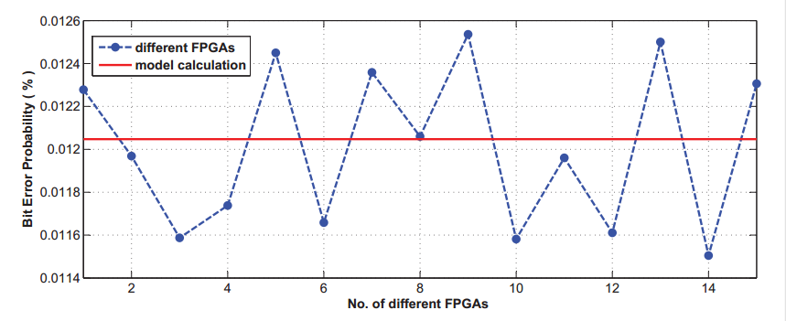
The sampling time interval is 2¹¹ oscillations of 50 MHz crystal oscillator.
The dot denotes the bit error probabilities from practical experiments, and the line denotes the bit error probability by model calculation.
Notes:
This is the figure that shows the bit error probability. The sampling time interval is eleven to the power of two oscillations of 50 MHz crystal oscillator. The dot denotes the bit error probabilities from practical experiments, and the line denotes that from model calculation.

Slide 33
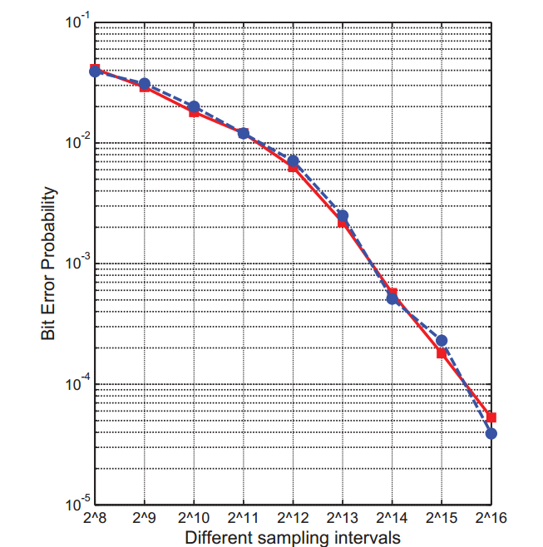
The sampling interval is from 2⁸ to 2¹⁶.
Notes:
This figure shows the error probabilities with the sampling interval from eight to the power of two to sixteen to the power of two. The blue dot is from experiments, and the red line is from model calculation. The model calculation and the experiments achieve high consistency.

Slide 34
Outline
Introduction
Analysis Model
Experiments
Conclusion
Notes:
Finally, is the conclusion

Slide 35
This paper proposes a bit error analysis model which utilizes the RO’s oscillating characteristics.
Experiments are conducted to demonstrate the validity of this new model and contributes to the evaluation scheme of RO PUFs.
Notes:
This paper proposes a bit error analysis model which utilizes the RO’s oscillating characteristics.
Experiments are conducted to demonstrate the validity of this new model and contributes to the evaluation scheme of RO PUFs.

Slide 36
Thank you !

