Slide 1
Software Security Maturity in Public Organisations
Martin Gilje Jaatun, Daniela S. Cruzes, Karin Bernsmed, Inger Anne Tøndel, and Lillian Røstad
@seniorfrosk

Slide 2
What did we do?
Questionnaire to 32 Norwegian public-owned (municipalities, government) organisations
Assumed to do internal development
20 responded (62,5 %)
Based on the Building Security In Maturity Model (BSIMM) activities
https://www.bsimm.com/

Slide 3
What is this BSIMM thing?
A study of 67 software development organisations and their software security activities
A framework that describes the various activities that are performed by a majority of the organisations covered
The concept Software Security Group is central
Those tasked with following up software security in an organisation

Slide 4
BSIMM Software Security Framework
Governance | Intelligence | SSDL Touchpoints | Deployment
Strategy and Metrics | Attack Models | Architecture Analysis | Penetration Testing
Compliance and Policy | Security Features and Design | Code Review | Software Environment
Training | Standards and Requirements | Security Testing | Configuration Management and Vulnerability Management
Domain
Practice

Slide 5
Who answered the questionnaire?
For some orgs, multiple people involved
Roles:
IT director
Head, Development department
Head of IT operations
Section manager IT
Section manager development
Group manager
IT manager
Development manager
Solution architect
Chief architect
System developer
IT advisor
Security manager
Information security manager
Security architect
Information security consultant
Security analyst
Security advisor
Senior engineer
Senior advisor

Slide 6
Questionnaire and follow-up
General background information
Position, number of developers, fraction of contractors, whether they contract for turnkey SW solutions
Concrete questions about which of the 112 BSIMM activities they perform on a regular basis
Yes/No/Don't know
Follow-up interviews
Telephone or teleconferencing solution
Latter allowed live sharing of filled-out questionnaire

Slide 7
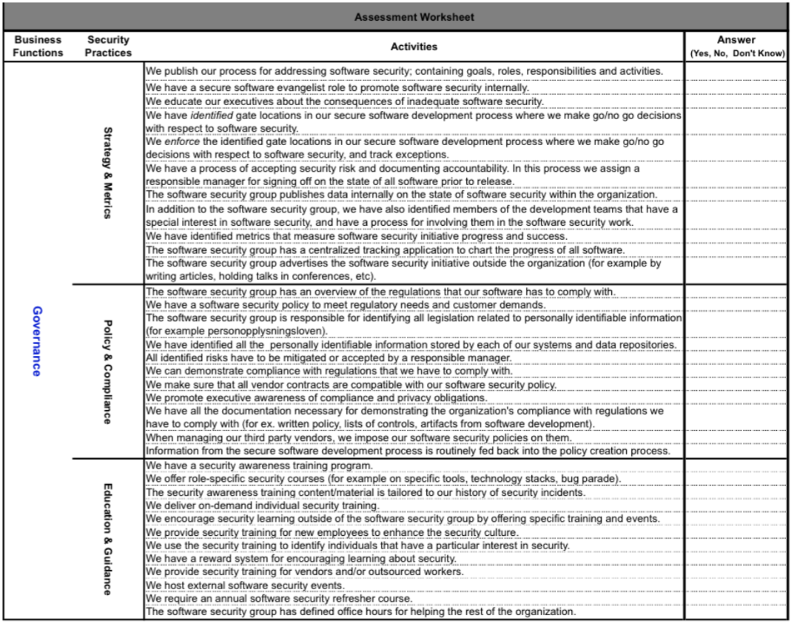

Slide 8
Data analysis & maturity measurements
Conservative maturity (0-3)
Org gets approved maturity level only if all activities on this and lower levels fulfilled ("Yes")
Weighted maturity (0-6)
High watermark maturity (0-3)
Same as BSIMM spider charts
If at least one activity on level 3, you get 3 (etc.)

Slide 9
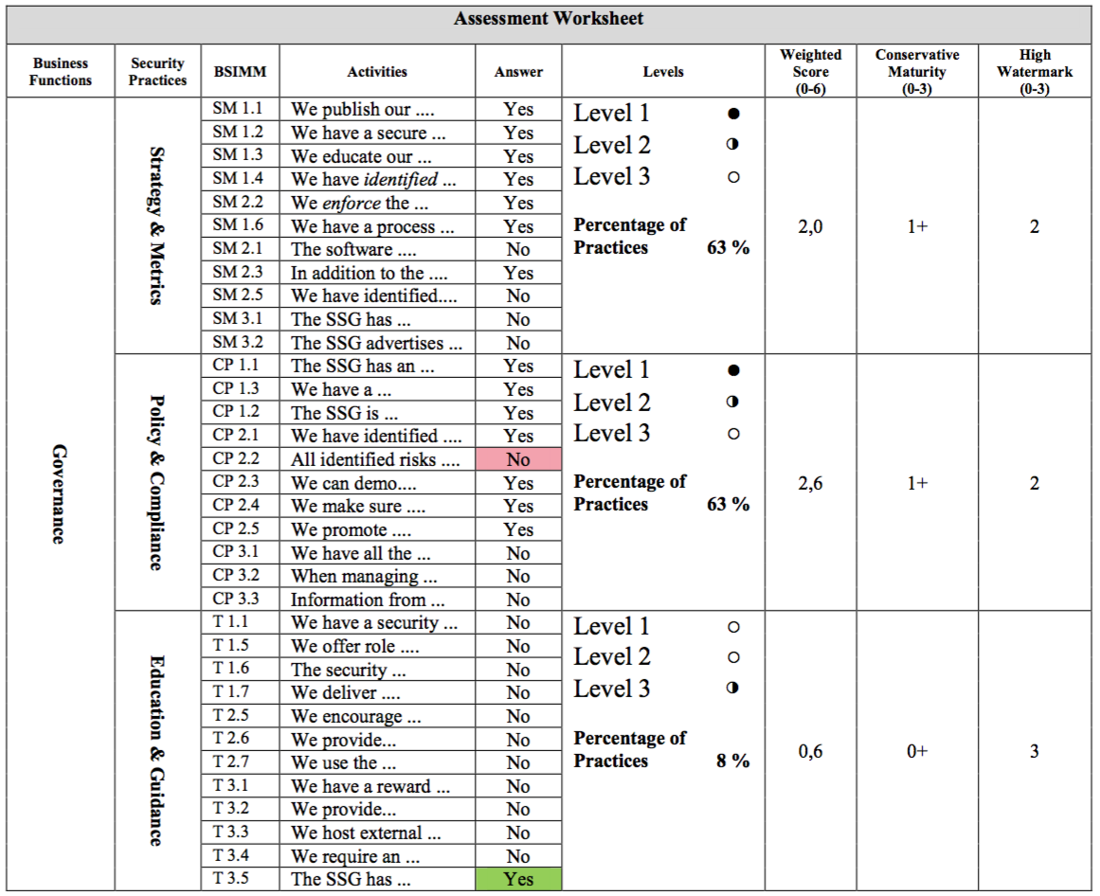
Example for imaginary organi- sation

Slide 10
Example, cont.

Slide 11
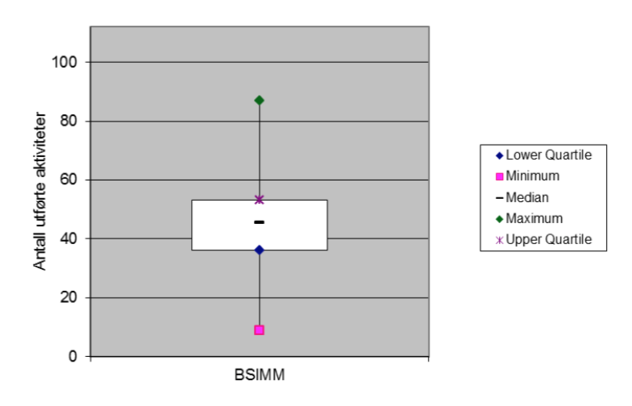
Distribution of # activities

Slide 12
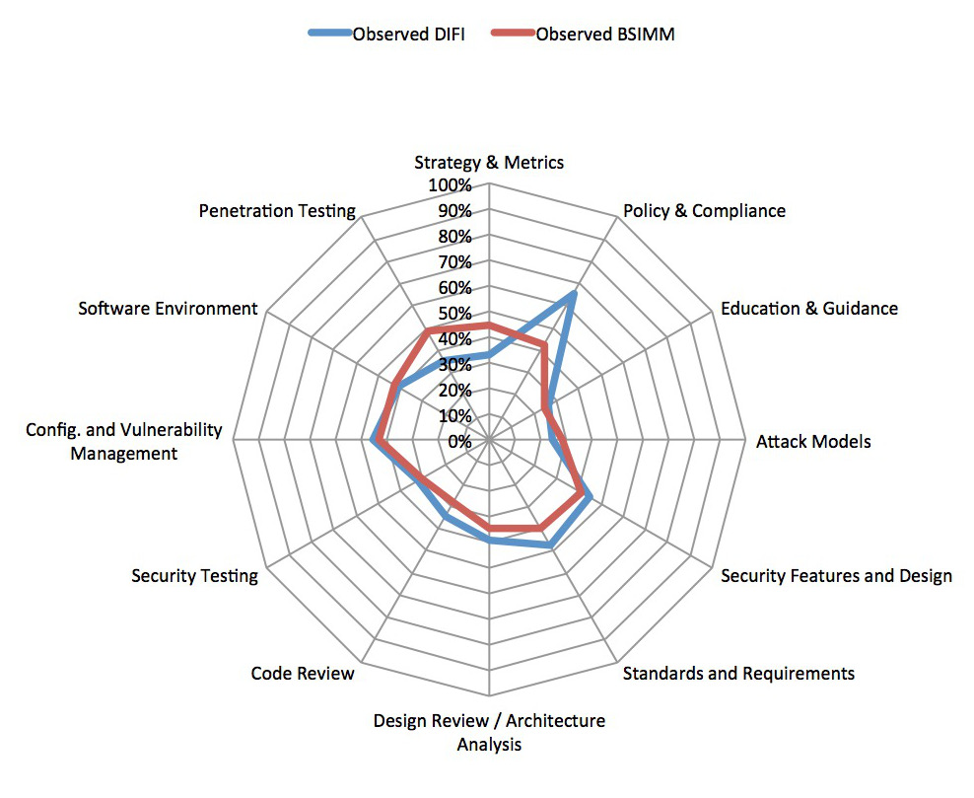
High-level averages
Caution!

Slide 13
The most common activities
https://www.flickr.com/photos/125207874@N04/14450220780/

Slide 14
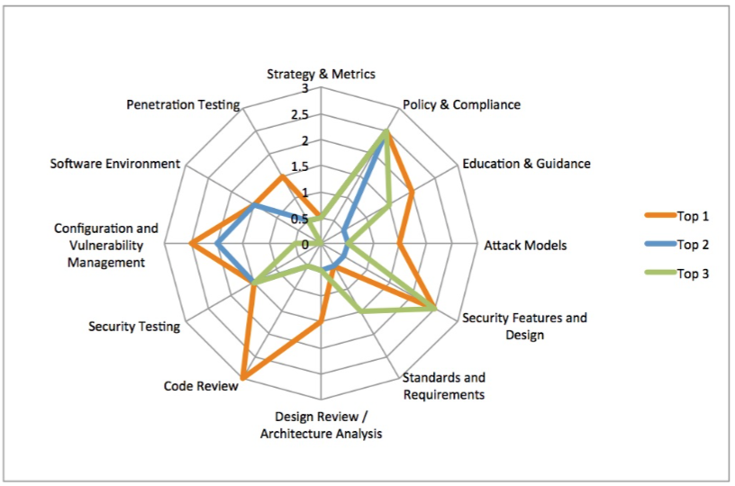
Conservative maturity for "top 3"

Slide 15
Selected practices
Governance | Intelligence | SSDL Touchpoints | Deployment
Strategy and Metrics | Attack Models | Architecture Analysis | Penetration Testing
Compliance and Policy | Security Features and Design | Code Review | Software Environment
Training | Standards and Requirements | Security Testing | Configuration Management and Vulnerability Management

Slide 16
Strategy and Metrics
Transparency of expectations and accountability of results
Management buy-in
One of the practices with lowest maturity
"Risk analysis is performed in the projects, but not for security"
"The regime worked well as long as we were doing waterfall, but more tricky with agile"
"High-level security risk analysis […] is not so useful in the development process"

Slide 17
Compliance and policy
Compliances with rules and regulation
Generate artefacts for audit
Highest maturity on all metrics
"We have many lawyers, and as an organisation we have many policies and regulations ensuring we cover compliance. Unsure how this affects the coding, though"

Slide 18
Penetration testing
Quality control
Discover security defects
At least half do the first two activities on level 1
But generally low maturity
"Initiatives to do pentest come […] from the network side. Testing is not done specifically of internally developed code or projects, but broader"

Slide 19
Software environment
Change management
Organisations have faith in their own level of host & network security
Important to remember that network security in general more mature than SWsec

Slide 20
Summary
What software security activities do vendors do?
Could be a long distance from legal expertise to developers
Different cultures between infrastructure and dev
Good that developers check each other's code
But do they have required SW sec skills?
Security managers are sent on training, not devs
Enterprise risk analysis not seen relevant to dev
Too little testing on security

Slide 21
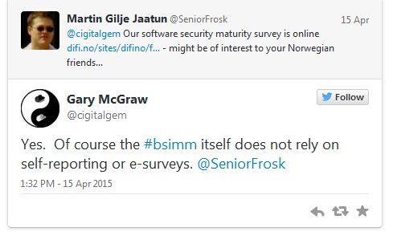
Could we do better?

Slide 22
?
Questions?
twitter.com/ SINTEF_Infosec
http://infosec.sintef.no
http://www.sintef.no/sos-agile

